Slide 1

AMAZON SALES
DATA ANALYSIS REPORT
GOUTAM KUIRI

Slide 2

Problem Statement
Objective
Benefits
Sales management has gained importance to meet increasing competition and the need
for improved methods of distribution to reduce cost and to increase profits. Sales
management today is the most important function in a commercial and business
enterprise.
Help out to make better business decisions.
Help analyze customer trends and satisfaction, which can lead to new and better products and services.
Gives better insight of customers base.
Helps in easy flow for managing resources.
Develop a Report by Extracting-Transforming-Loading of data which contains Sales trend with respect to Year, Month, Quarter and find Some relationships through data to understand and Analyze the Facts.

Slide 3
Quick Insight
﻿A quick insight for 2010 to 2017 amazon sales.
512.87k
Total Sales QTY
137.35M
Total Revenue
123.98M
LY Revenue
12
Total Items
44.17M
Total Profit

Slide 4
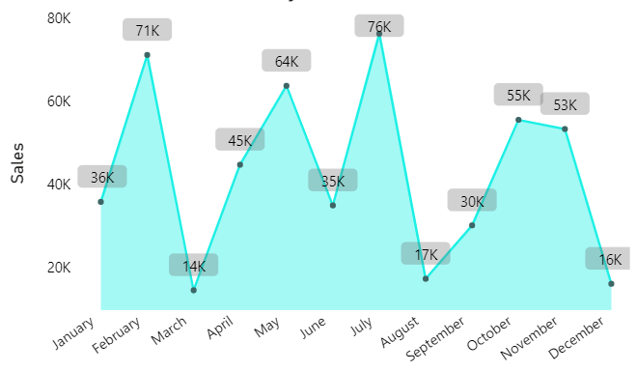
Monthly Sales Trend
﻿July month is highest sales at 76k and March month lowest sales at 14k.﻿

Slide 5
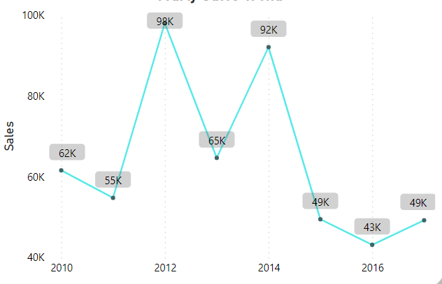
Yearly Sales Trend
﻿2012 is highest sales at 98k and Revenue will generate at 31.9M , 2016 is lowest sales at 43k and Revenue will generate at 12.37M.﻿

Slide 6
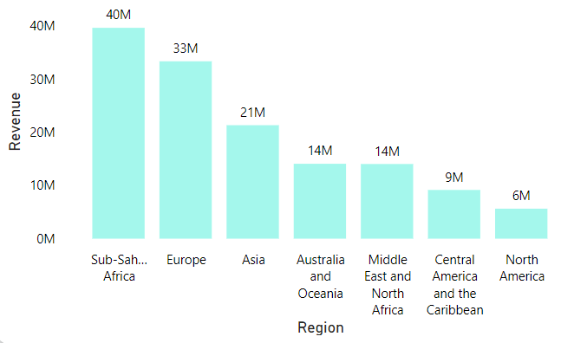
Region Wise Revenue
Sub-Sharan Africa Region 24 country present and revenue will generate 40M , North America Region only one country present Mexico so less revenue will generate 6M.

Slide 7
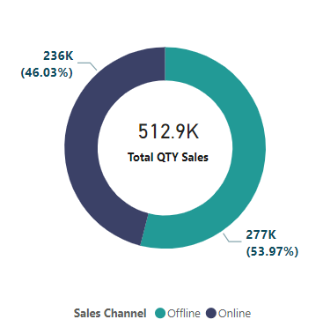
Channel Wise QTY Sales
Offline Product Sales Total Qty is 277K(53.97%) or revenue will generate 79.09M and Online Product sales Total Qty is 236K(46.03%) or revenue will generate 58.25M. Total Qty sales is 512.9K. If the customer has more trust in buying the product offline so will have to win the trust of customers in the product buy in online because reduce cost.

Slide 8
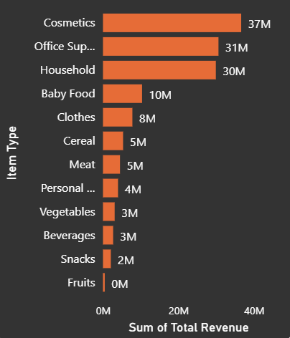
Top Products Sold w.r.t revenue
﻿The Cosmetics and Office Supplies are the products with highest sales in terms of revenue from all 12Items.

Slide 9
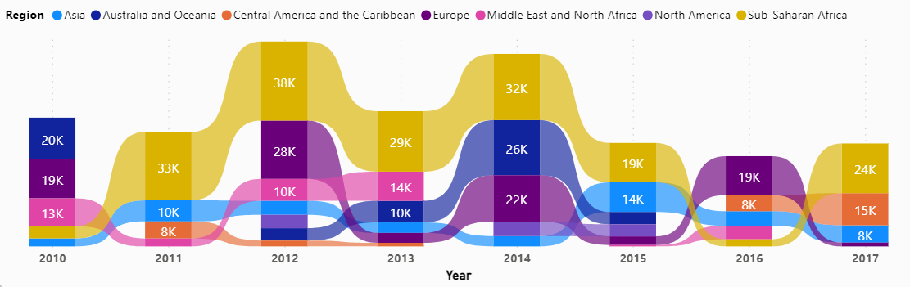
Region wise QTY Sold by Year
Sub-Saharan Africa region more Qty sold 38K in year 2012 and mostly years more product sales like 2011, 2012, 2013, 2014, 2017. Sub-Saharan Africa region 2011 to 2015 top seller but suddenly 2016 sales will decrease 81.98%.

Slide 10
Conclusion
2012 had the highest Revenue at 31.9M, and 2011 had the lowest Revenue at 11.1M.
2. If we observe the monthly insights of 2010 to 2017 the sales are at their peak in February , May, and July and are low in March ,August, &December. Amazon can come up with some good discounts and offers to generate high revenue.
3. The sales for the Honduras are highest among all countries and lowest in Kuwait.
4. The Cosmetic & office supplies are the highest Revenue generate products in domestic and international markets.
5. Offline channel generate more sales 277K comparison to online channel sales 236K.

